Slide 1





Myntra Analysis Project
GUVI CAPSTONE PROJECT - 3

Slide 2

Skills and Objectives
Skills Acquired:
- Brand Perception Analysis
- Customer Sentiment Analysis
- Market Trends Identification
- Strategic Recommendations
Objective:
- Evaluate Myntra's online reputation
- Provide actionable recommendations

Slide 3


Tools and Approach
Data Sources:
- Social Media (Twitter, Instagram)
- Review Platforms (Google Reviews)
Tools Used:
- Sentiment Analysis: TextBlob, VADER
- Visualization: Tableau, Power BI
- Trend Monitoring: Google Trends
This Photo by Unknown Author is licensed under CC BY-SA-NC

Slide 4
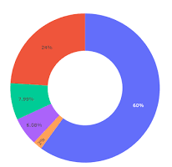
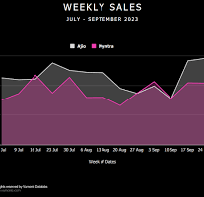
Business Use Cases
Brand Perception: Understand customer feedback
Customer Satisfaction: Identify areas of improvement
Market Trends: Track preferences and hashtags
Competitive Landscape: Benchmark against competitors

Slide 5
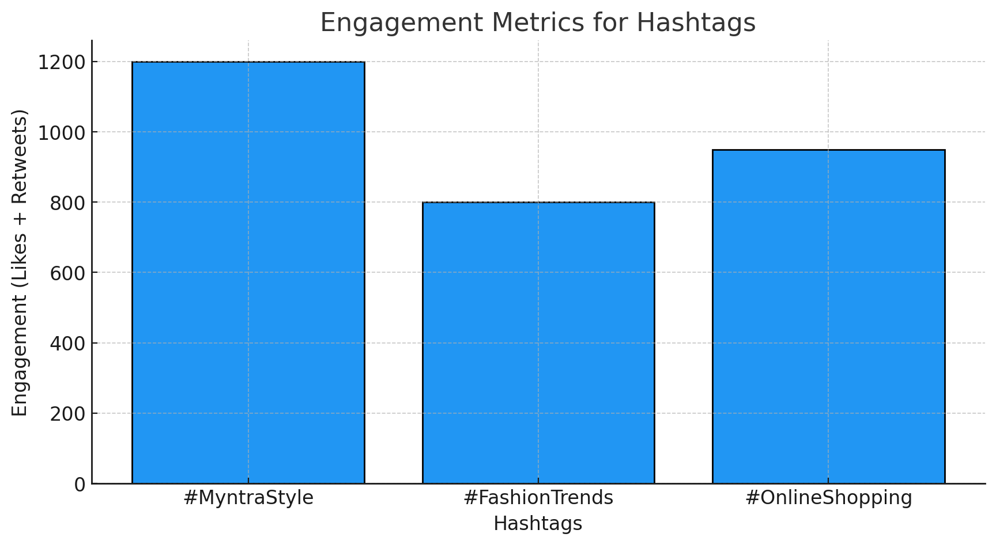
Data Collection Process
Social Media Insights:
Posts were collected using hashtags like #MyntraStyle, #FashionTrends, and #OnlineShopping on Twitter, Instagram, and Facebook platforms.
Sentiment analysis was applied to categorize posts into positive, negative, or neutral sentiments.
Positive: "Absolutely love the ethnic wear collection on Myntra! Perfect for the festive season. 🌟 #MyntraStyle“
Negative: "Frustrated with delayed deliveries. Myntra needs to improve logistics. 😡 #OnlineShopping"

Slide 6
Customer Reviews
Reviews were scraped from Google Reviews and Trustpilot using BeautifulSoup.
Focus areas included:
Service Quality: "The customer service team resolved my query promptly!"
Product Usability: "The app interface is user-friendly but refund processes are slow."
Delivery Performance: "Delivery time exceeded expectations!"

Slide 7
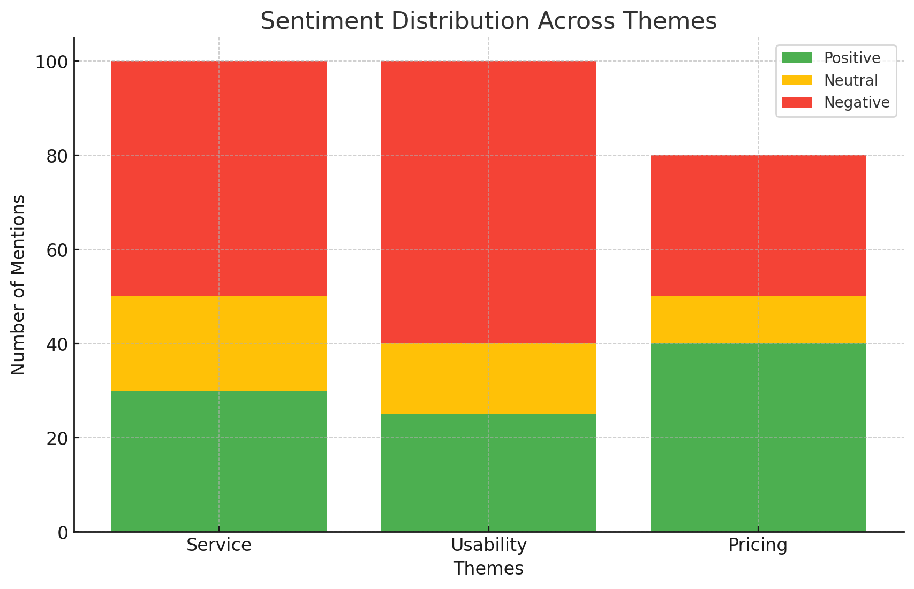
Categorization
Extracted data was grouped into major themes:
Service: Delivery speed, customer support interactions.
Product Usability: Ease of app navigation, variety of collections.
Pricing: Affordability, discounts, and sale reviews.

Slide 8
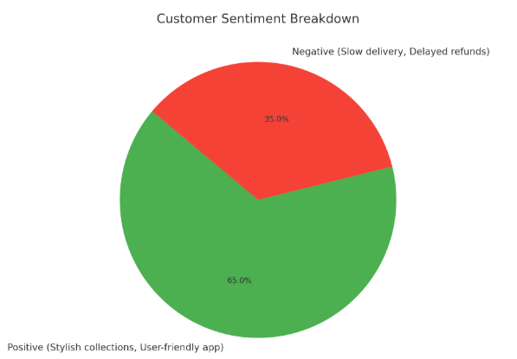
Brand Perception Analysis
Positive: Stylish collections, user-friendly app
Negative: Delayed refunds, slow delivery
Tools Used: VADER, TextBlob
Visualization: Pie chart showing sentiment breakdown
It looks like customers are happy with Myntra's stylish collections and user-friendly app, but there is also some dissatisfaction with slow delivery and delayed refunds.

Slide 9
Customer Sentiment Insights
Positive Sentiments:
Customers are particularly pleased with Myntra's high-quality festive collections, which meet their expectations for style and variety during seasonal events.
Continued praise for the user-friendly app and stylish collections further boosts customer satisfaction.
Negative Sentiments:
Refund Delays: Persistent issues with delayed refunds have left customers frustrated, impacting their overall trust in the brand.
Delivery Issues: Slow or inconsistent delivery services, especially during high-demand periods, are a recurring complaint among customers.
Tools: NLTK, VADER (NLP tools)
Visualization: Power BI dashboard

Slide 10
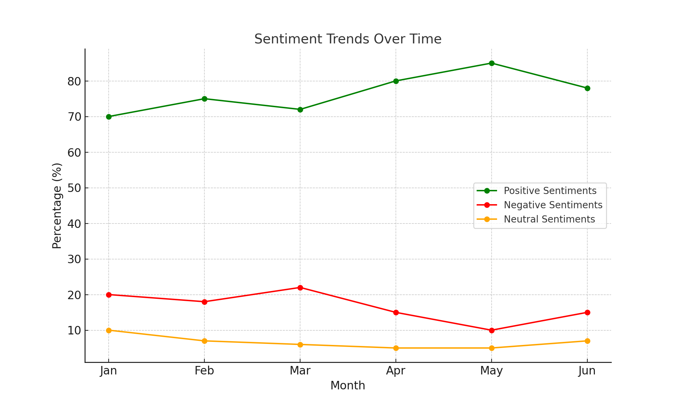
Sentiment Trends Analysis:
Positive Sentiments: Show a steady rise from January to May, indicating increasing customer satisfaction, attributed to stylish collections and user-friendly app improvements.
Negative Sentiments: Decrease from February to May but slightly rise in June, possibly due to seasonal factors affecting delivery services.
Neutral Sentiments: Remain relatively stable, reflecting a consistent portion of factual or inquiry-based feedback.
This visualization highlights the need to sustain the positive trend while addressing periodic negative feedback spikes

Slide 11
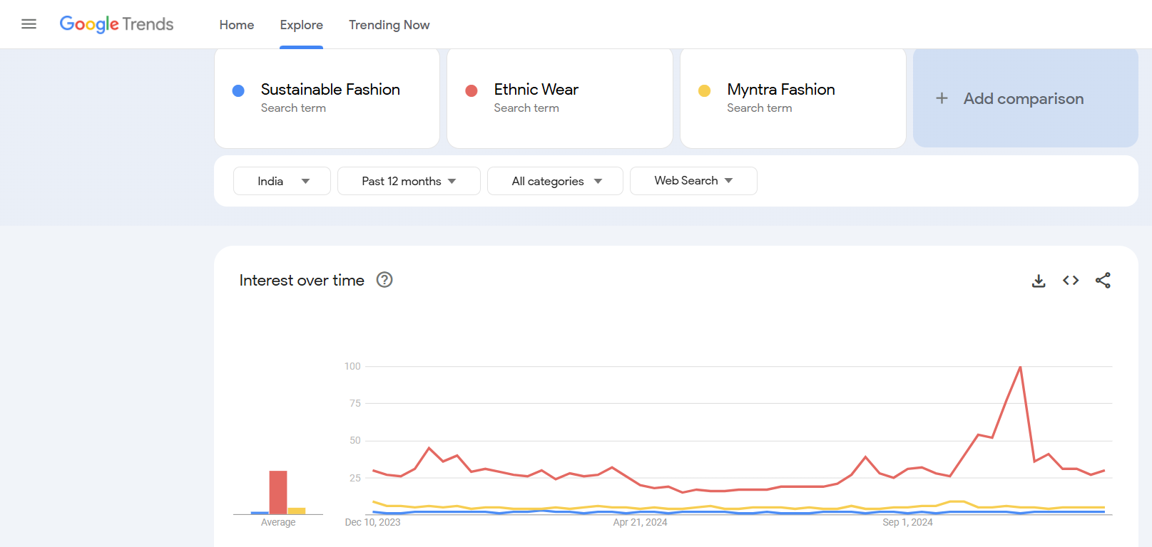
Market Trends Identification
Emerging Trends: Sustainable Fashion: Growing demand for eco-friendly clothing. Myntra can highlight sustainable collections prominently.
Ethnic Wear: Consistent popularity, especially during festive seasons. Continue offering diverse ethnic collections.
Influencer Impact: Influencers drive engagement with Myntra’s seasonal and ethnic collections using hashtags like #MyntraStyle and #FestiveFashion.
Tools Used: Google Trends, RiteTag

Slide 12
Market Trends Identification
Recurring Themes:
Sustainable Fashion: Feature eco-friendly products on the homepage with banners like "Sustainable Styles for You."
Ethnic Wear: Promote ethnic wear during peak seasons with banners like "Festive Style at Myntra.

Slide 13
Competitive Landscape
1. Identifying Competitors:
Myntra operates in a competitive e-commerce fashion space, with primary competitors being:
Amazon Fashion: Known for its extensive product range and competitive pricing. However, it struggles to deliver the specialized focus on fashion that Myntra excels in.
Flipkart Fashion: Offers attractive discounts and a broad customer base but has limitations in premium collections.
AJIO: Gaining popularity for unique styles and curated collections but has a smaller product catalog compared to Myntra.
Competitor insights were gathered from social media platforms and customer reviews to analyze their positioning and performance in the market.

Slide 14
2. Comparing Myntra with Competitors:
Criteria | Myntra | Amazon Fashion | Flipkart Fashion | AJIO
Product Range | Extensive fashion focus | Wide variety (non-focused) | Large, generic | Unique, curated
Pricing | Moderate, seasonal discounts | Competitive | Discount-driven | Moderate to High
Customer Satisfaction | Strong in app usability | Broad satisfaction | Mixed reviews | Positive for uniqueness
Social Media Presence | Active campaigns, influencers | Limited fashion focus | General presence | Growing presence
Myntra’s Competitive Advantages:
Specialized focus on fashion and lifestyle compared to general marketplaces.
Strong social media campaigns and influencer collaborations that resonate with target customers.
Highly user-friendly app and seamless shopping experience.
Myntra's Disadvantages:
Delivery delays and refund issues weaken customer satisfaction.
Needs to diversify into sustainable fashion to meet growing eco-conscious demands, where competitors are gaining ground.
Tools: SimilarWeb, SWOT Analysis & SemRush

Slide 15
Strategic Recommendations for Myntra
1. Enhance Delivery Speed:
Implement AI-driven routing systems to optimize delivery routes and reduce delays.
Partner with third-party logistics providers for high-demand periods to improve speed and efficiency.
2. Streamline Refund Processes:
Introduce real-time refund tracking within the Myntra app to improve transparency and customer trust.
Automate refund approvals for simpler cases to speed up processing times.
3. Focus on Sustainability:
Launch a dedicated Myntra Green section promoting eco-friendly products.
Collaborate with brands specializing in sustainable fashion and feature them prominently on the website.

Slide 16
Strategic Recommendations for Myntra
4. Personalization:
Use AI-based recommendation engines to provide tailored suggestions for customers based on browsing and purchasing history.
Create personalized campaigns featuring trending collections, like ethnic wear during festivals or sustainable styles year-round. These strategies aim to address key pain points (delivery delays, refund issues) and leverage Myntra’s strengths (trend-driven marketing and sustainability focus) to enhance customer satisfaction and brand loyalty.

Slide 17
Conclusion and Next Steps
Myntra’s focus on leveraging insights from social media and customer reviews provides a roadmap to strengthen its market position. By addressing key challenges like delivery delays and refund issues while capitalizing on opportunities such as emerging fashion trends and sustainability, Myntra can enhance its online reputation and customer loyalty.
Next Steps:
Expand regional campaigns using targeted strategies like Google Ads.
Track trends continuously to adapt to customer preferences.
Optimize operations with efficient logistics and refund systems.
These recommendations align with Myntra’s goal of improving its competitive edge and fostering long-term growth.

